Slide 1
RUNTIME VERIFICATION
RAMESH S. & ARUN A.
CS 522 – EMBEDDED SYSTEMS | IIT-G
NOVEMBER 9, 2023

Slide 2
Introduction
Runtime Verification (RV) involves analyzing an execution trace of a system or application
Complements verification techniques such as model checking and theorem proving
The system can be a software system, hardware or cyber-physical system, a sensor network, or any system in general whose dynamic behavior can be observed
To check whether the runtime behavior of a system conforms to a specification there are three necessary steps
Specify (un)desired system behavior
Create monitor from specification
Connect monitor to a system – system instrumentation to extract information
Notes:
Introduction to runtime verification. Ezio Bartocci et al.

Slide 3
System Behavior Specification

Slide 4
Abstraction
System behavior: how system changes over time by
Updating internal state(s)
Taking internal or external action
Affecting the environment
Describe behavior in terms of observations
Observations:
Snapshot of current state of system at time T
Record actions or state changes made by the system
Notes:
Introduction to runtime verification. Ezio Bartocci et al.

Slide 5
Events and Traces
Events
Any kind of observation about the system
Defined at different levels of abstraction
Could be about an internal or external behavior
Cover the whole or part of a system
Traces
Behavior of a single run of a system
Finite sequence of events or a set of events
Multiple observations may occur concurrently
Ordering of events
Notes:
Introduction to runtime verification. Ezio Bartocci et al.

Slide 6
Property:
Desired behavior or characteristic that the system should exhibit
Represents a requirement or a constraint that the system must satisfy
Specification techniques:
Temporal logic: specify properties over time
Property: "Whenever a user presses the emergency stop button, the system should immediately halt all motor operations.”
LTL Specification: G (ButtonPressed -> F MotorHalted)
Property Specification

Slide 7
Property Specification
- Contd.
Specification techniques:
State Machines: define states and transitions between them. Properties specify desired sequence of states or conditions for state transitions.
E.g.: in a medical device, a property specified using state machines could be "The device should transition from the 'idle' state to the 'active' state only when the user provides a valid authentication code.“
Assertions: statements that should always hold true during system execution
E.g.: in a communication system, an assertion-based property could be "The received data packet should have a valid checksum before being processed."

Slide 8
Specifications to Monitors

Slide 9
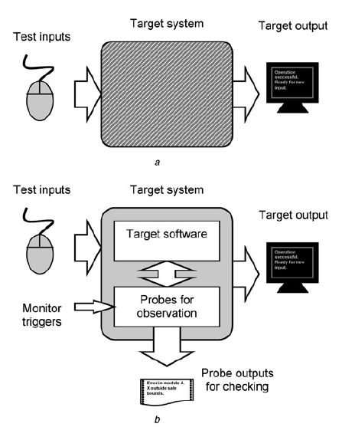
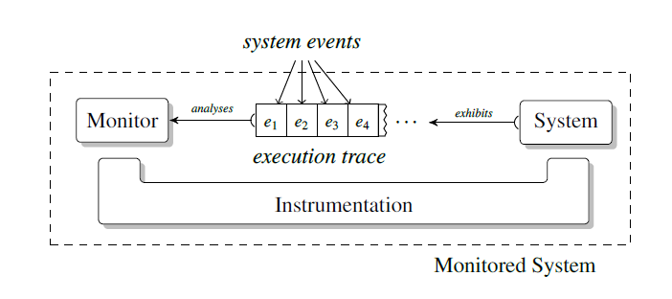
Monitoring - Basics
Black-box View
Computational entities that execute along side a system to observe its runtime behavior and possibly determine whether a property is satisfied or violated from the exhibited (system) execution
Outputs for Monitoring
Notes:
Runtime verification and monitoring of embedded systems. Watterson and Heffernan.

Slide 10
Challenges
Observability
Minimize interference with target application/system
Constraints: resources and timing.
Notes:
Runtime verification and monitoring of embedded systems. Watterson and Heffernan.

Slide 11
Monitor Types
Offline: analysis is carried out after the system executes. Less intrusive. Enable global analysis.
Online: during system execution. Stringent requirement for low overhead.
Synchronous: system and monitor execute in lock-step
Asynchronous: detaches monitor execution from that of the system
Notes:
Runtime verification and monitoring of embedded systems. Watterson and Heffernan.

Slide 12
Guideline
What to measure?
Why the measurement should be taken?
What is the purpose of monitoring? Debugging, testing, or verification
Notes:
Runtime verification and monitoring of embedded systems. Watterson and Heffernan.

Slide 13
Instrumentation

Slide 14
Instrumentation - Basics
Computational plumbing that connects execution of a system under scrutiny with the analysis performed by the monitor
What? Record relevant information as system events with proper ordering or partial ordering
How? System terminates execution before monitor starts or monitor execution is interleaved in separate threads

Slide 15
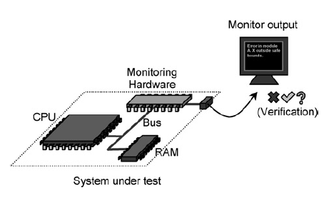
Hardware Monitors
Dedicated components or circuits integrated into the embedded system’s hardware
Continuously monitor and track aspects like temperature, voltage levels, clock frequency, power consumption
Thresholds specification: need to ensure system operates within safe and optimal limits
Threshold violation would trigger actions such as generating an interrupt, shutting down the system, or activating fault-tolerant mechanisms

Slide 16
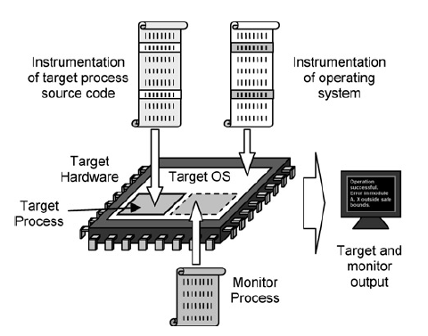
Software Monitors
Implemented as part of the software
Responsible for monitoring execution for anomalies or failures
Periodically check “heartbeat” signals or execute predefined tasks at regular intervals
Trigger actions such as system reset or error recovery procedures in case of violation

Slide 17
Adaptive Cruise Control (ACC) System

Slide 18
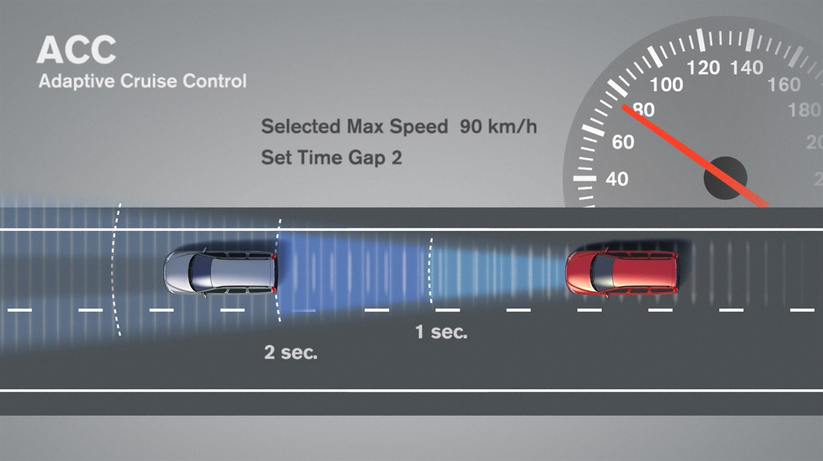
Intro to ACC System
The purpose of an adaptive cruise control (ACC) system is to maintain a desired speed and maintain a safe distance from a lead vehicle.
The driver engages ACC system by pressing a button and entering inputs such as desired speed (V_{set}) and following time gap (T_{gap}).
The system uses sensors such as RADAR, LiDAR, and stereoscopic cameras to measure the distance to the preceding vehicle and relative velocity to the lead car to regulate the speed.
Hereafter, we’ll refer to the vehicle that is equipped with ACC as Ego vehicle.

Slide 19
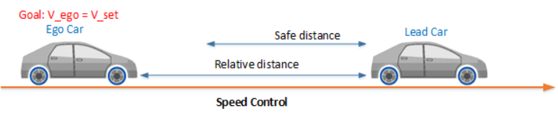
ACC Modes
Speed Control Mode:
The ego car travels at a driver-set speed
Speed control mode is active when the ego maintains a safe distance with the lead car, i.e., D_{rel} >= D_{safe}
The control goal in this mode is to track the driver-set velocity, V_{set}

Slide 20
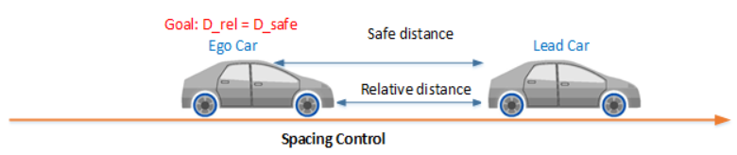
ACC Modes – Contd.
Spacing Control Mode:
The ego car maintains a safe distance from the lead car
Spacing control mode is active when the lead car is too close, i.e., D_{rel} < D_{safe}
The control goal in this mode is to maintain safe distance, D_{safe}

Slide 21
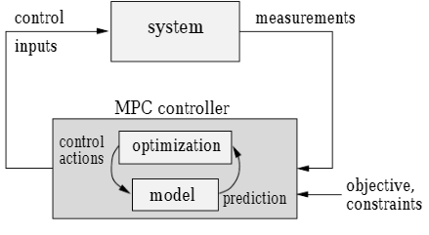
Model Predictive Control (MPC)
MPC is an optimization strategy using model of the system
Optimization is performed for a specific (moving) time horizon
Allows one to impose constraints
Works for a non-linear system as well
Compute intensive to run optimization online

Slide 22
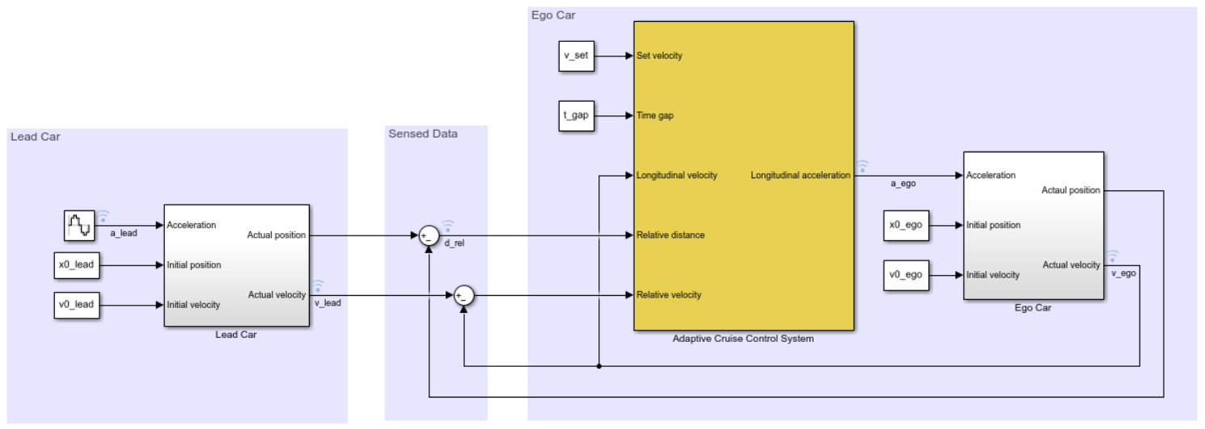
MATLAB/Simulink Implementation

Slide 23
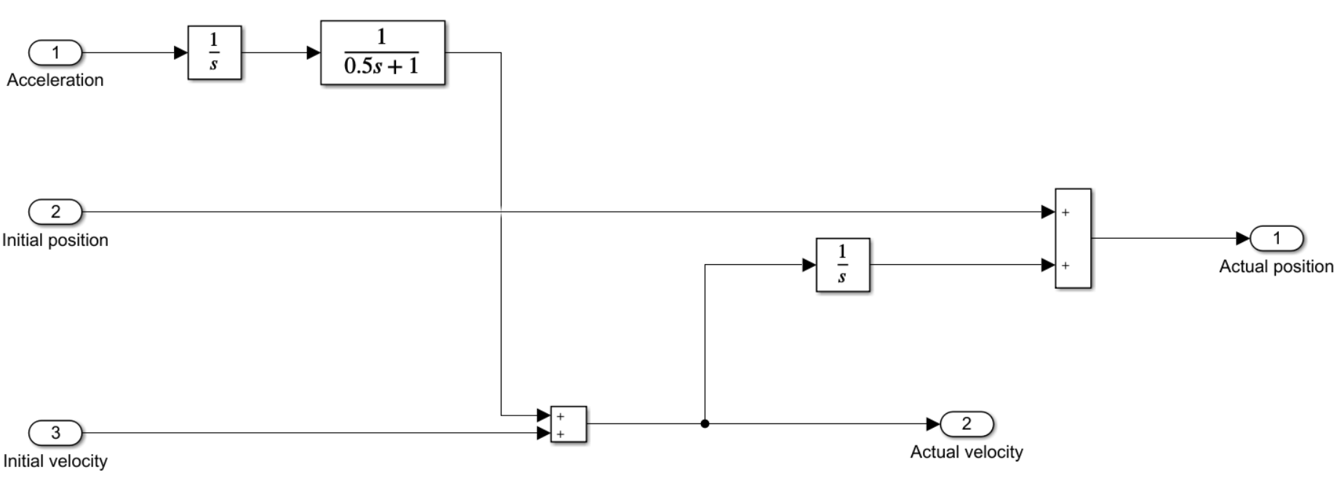
Vehicle Dynamics Model
For both the ego vehicle and the lead vehicle, the dynamics between acceleration and velocity are modeled as: G = $\frac{1}{s(0.5s+1)}$
The initial positions (x0_lead, x0_ego) and velocity (v0_lead, v0_ego) for the two vehicles are specified in m and m/s respectively.
The acceleration of the lead car is varied according to a sine wave during the simulation

Slide 24
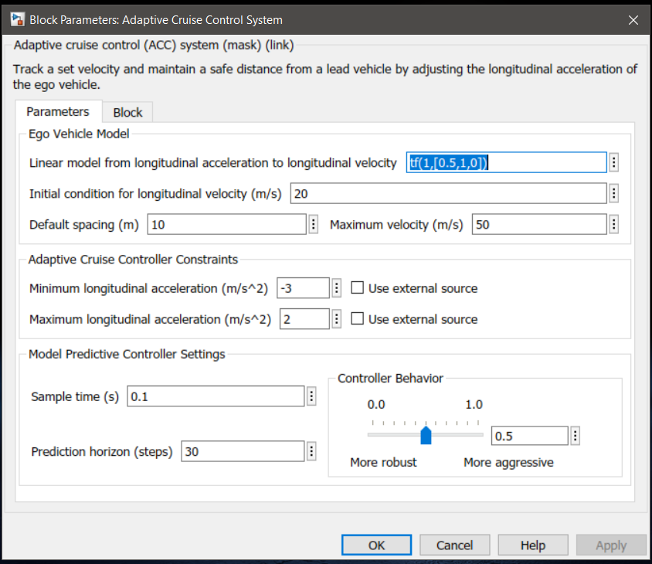
MPC Settings
Model: Same linear second order model used for vehicle Ego and lead vehicle dynamics
Inputs
Ego vehicle velocity setpoint, V_{set} (m/s)
Time gap, T_{gap} (sec.)
Longitudinal velocity, V_{ego} (m/s)
Relative distance, D_{rel} (m)
Relative velocity, V_{rel} (m/s)
Output
Longitudinal acceleration (m/s²)
Constraints
Max and min longitudinal acceleration (m/s²)

Slide 25
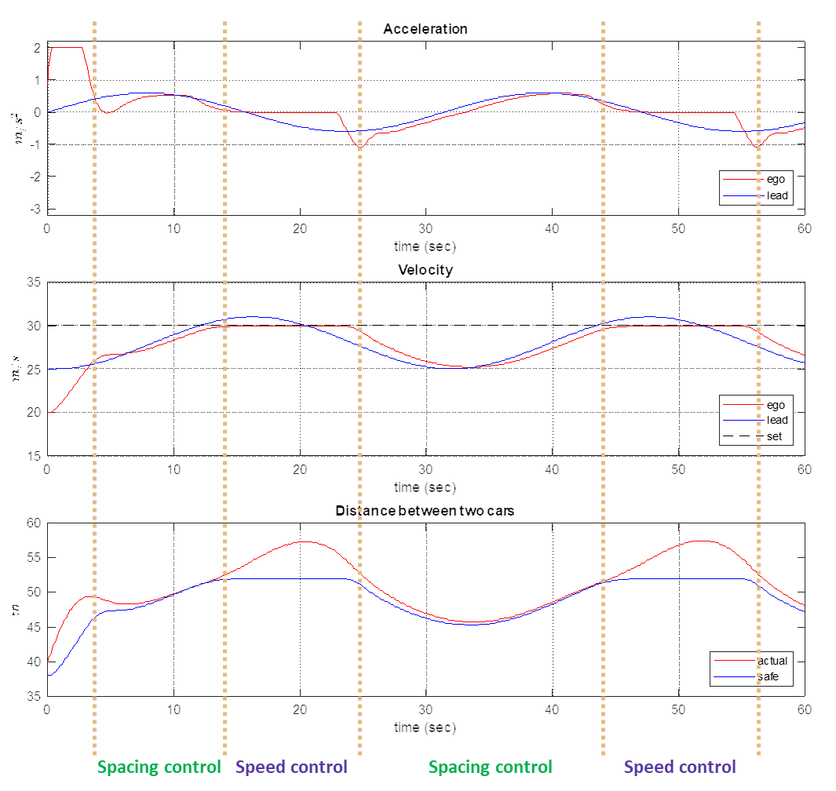
Result: Balanced MPC Controller

Slide 26
Result: Aggressive MPC Controller

Slide 27

ACC Safety Property
Collision-freedom in an ACC system can be achieved iff there is always a safe distance between two successive vehicles
sc_{gap}: safe distance; v_{l}, v_{h}: lead and host vehicles’ velocity; B: max deceleration achieved by max brake force
The length of sc_{gap}(v_{l},v_{h}) should be such that the host vehicle can fully stop at the rear end of the lead vehicle or the end of sc_{gap}(v_{l},v_{h}) in the worst-case scenario where the lead vehicle may itself be suddenly using the same maximum brake force to come to a full stop
Simulink implementation demo

Slide 28
Property Proving Workflow in Simulink

Slide 29
Property Proving Workflow
Model safety requirements as properties and then verify the design model against requirements
When you perform property proving analysis, Simulink Design Verifier generates a counterexample that you use to debug the property violation
Example: Cruise Control System
PI Controller that computes the throttle output based on the difference between the actual and target speed
Simulink design verifier (SDV) generates a summary report of property proving analysis
Debug property violations using the harness model
Iterative process:
Redesign the system
Redefine the property

